Slide 1















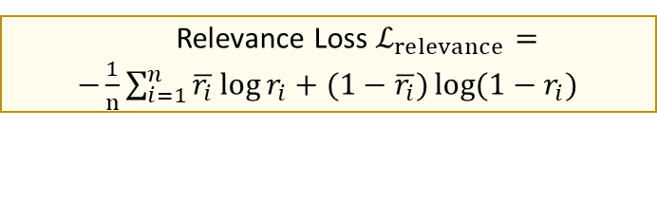














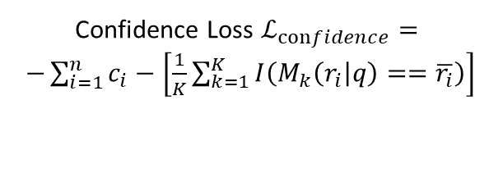














$$y_{ans}$$
Answer Token
$$\overline{r_{i}}$$
Passage Relevance Label
$$I(⋅)$$
Indicator Function
$$H(⋅)$$
Entropy Function
$$M_{k}\left(r_{i} | q\right)$$
Relevance Score Predicted by k-th External Model
Relevance Loss $ℒ_{relevance}=$
$−\frac{1}{n}\sum_{i=1}^{n}{\overline{r_{i}}\log{r_{i}}+(1−\overline{r_{i}})\log{{(1−r}_{i}}) }$
$$×M$$
3
$$α_{1}$$
$$α_{n}$$
4
1
$$…$$
Update
Answer Token
Concat
Confidence Loss $ℒ_{confidence}=$
$−\sum_{i=1}^{n}{c_{i}−\left[\frac{1}{K}\sum_{k=1}^{K}{I\left(M_{k}\left(r_{i} | q\right)==\overline{r_{i}}\right)}\right]}$
Lora Weight
Linear Head
2
1
2
$$r_{1}$$
$$r_{n}$$
$$c_{1}$$
$$c_{n}$$
$$H_{1}$$
$$H_{n}$$
$$…$$
$$…$$
$$…$$
$$×N$$
Relevance-aware Passage Fusion
Diversity Loss$ℒ_{diversity}=−H(α_{1},…,α_{n})$
3
Relevance
Confidence
Adaptability
…
…
…
$$e_{q}$$
$$d$$
…
$$e_{1}$$
$$d$$
$$e_{n}$$
$$q$$
Language Model Loss $ℒ_{LM}=$
$$−log p(y_{ans}|q,p_{1},…p_{n})$$
Layer-wise
Passage Estimator
4
Adaptor
$$p_{1}$$
…
$$p_{n}$$
$$q$$
$$p_{1}$$
…
$$p_{n}$$
$$q$$
…
Lora Weight
LLM Decoder Layer
Lora Weight
LLM Decoder Layer
$$p_{1}$$
$$p_{1}$$
…
Blocked Bidirectional Attention Mask
Relevance-Guided Attention Mask
…
…
…
…
…
…
…
…
…
…
…
$$p_{n}$$
…
$$e_{1}$$
…
…
$$e_{n}$$
$$q$$
…
$$e_{q}$$
$$p_{n}$$
…
$$d$$
$$d$$
$$p_{1}$$
$$p_{n}$$
$$q$$
$$q$$
…
$$q$$
…
Adding Special Tokens
$$α_{1}$$
$$…$$
$$α_{n}$$
Passage Relevance
…
…
…
…
Blocked Bidirectional Attention Mask
Relevance-Guided Attention Mask
Passage 1
Passage n
Question

